Slide 1
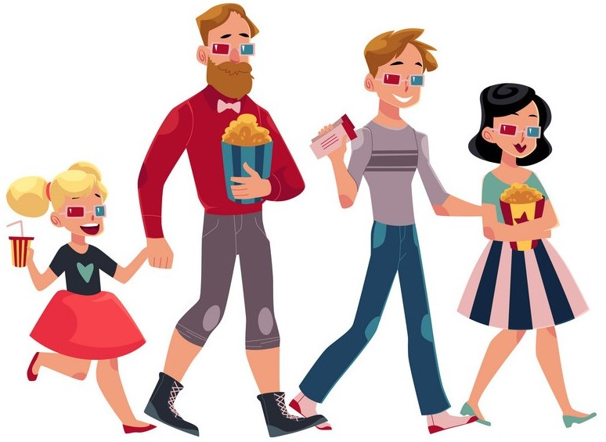
Unit
8
FILMS
PERIOD:62 -LESSON 1: GETTING STARTED P:82-83
Let’s go to the cinema tonight!
Unit
HOBBIES

Slide 2
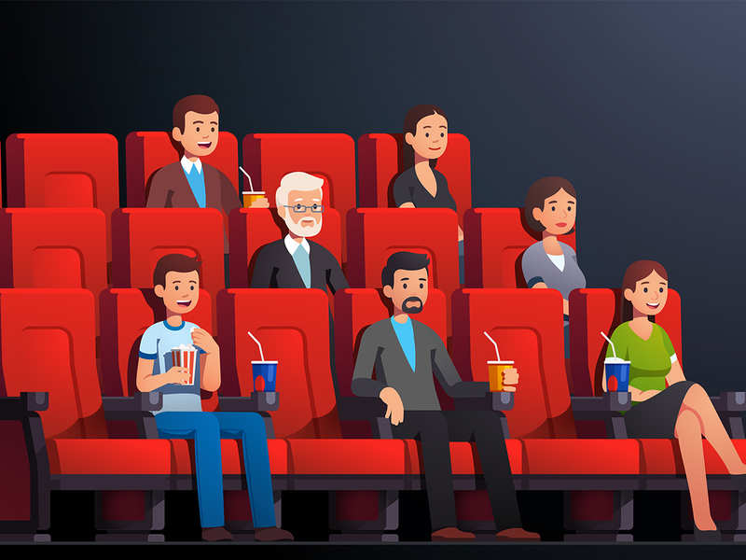
LESSON 1: GETTING STARTED
WARM-UP
Chatting

Slide 3
WARM-UP
What did you do last night after finishing your homework?
Do you like watching film?

Slide 4
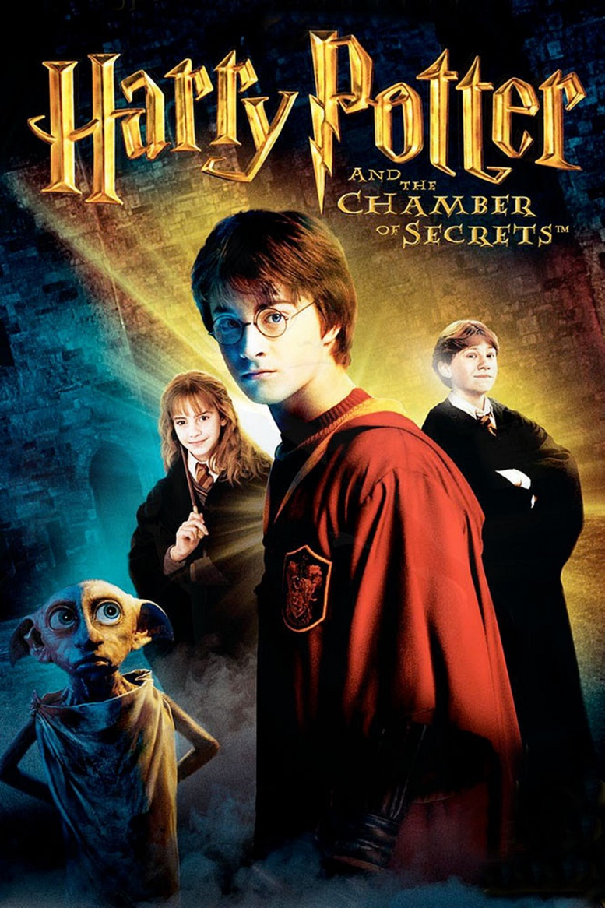
I.VOCABULARY
fantasy (n)
/ˈfæntəsi /
phim viễn tưởng

Slide 5
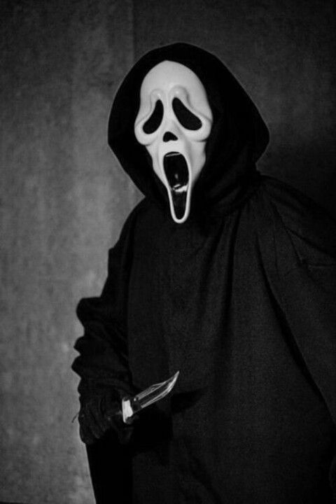
horror film (n)
/'hɒrə fɪlm/
phim kinh dị

Slide 6
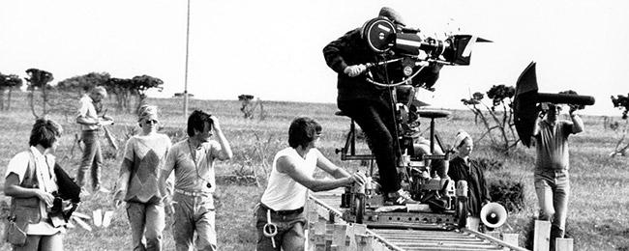
documentary (n)
/dɒkjʊˈmentəri/
phim tài liệu

Slide 7
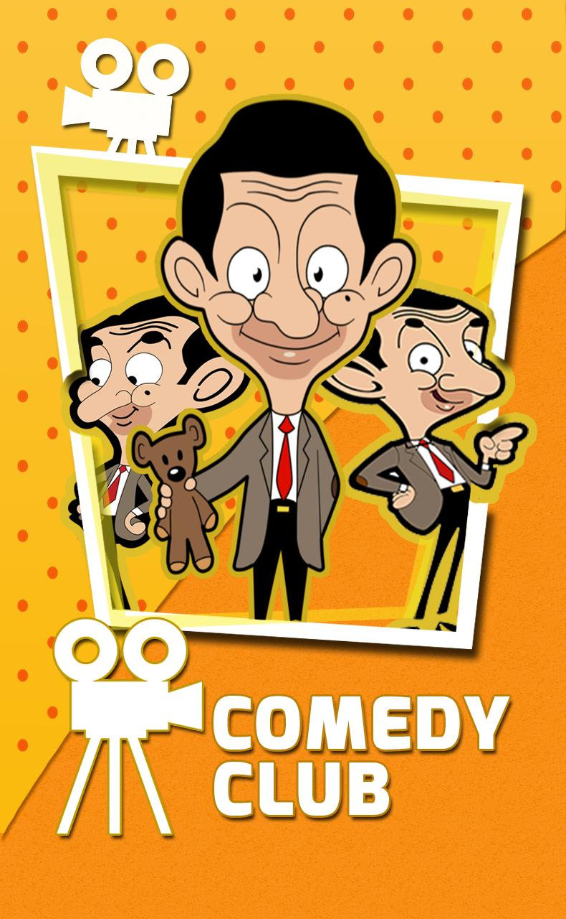
comedy (n)
/ˈkɒmədi/
phim hài

Slide 8
Vocabulary | Pronunciation | Meaning
horror film | /'hɒrə fɪlm/ | phim kinh dị
documentary | /dɒkjuˈmentri/ | phim tài liệu
comedy | /ˈkɒmədi/ | phim hài
fantasy | /ˈfæntəsi / | phim viễn tưởng

Slide 9
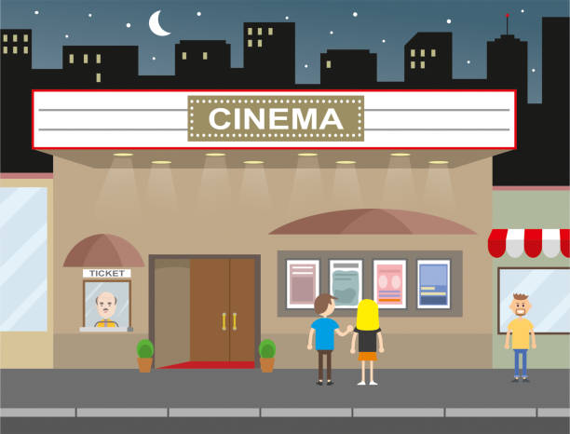
II.PRACTICE
1
Listen and read.

Slide 10
Mark: Let's go to the cinema tonight!
Mi: Good idea! What shall we see?
Mark: A Nightmare is on at Sao Mai Cinema tonight.
Mi: Is it a fantasy?
Mark: No, it's a horror film.
Mi: That's too scary for me. Look! An Old Pier is on at Town Cinema. It's a documentary.
Mark: I don't really like documentaries. They're often boring. What about Our Holiday?
Mi: What kind of film is it?
Mark: It's a comedy.
Mi: And who stars in it?
Mark: Kate Harrison and Lily Collins.
Mi: Um, they're pretty good. What's it about?
Mark: It's about two women living in different countries and they decide to exchange houses.
Mi: What are the reviews like?
Mark: Well, although a few people say it's a bit silly, most say it's funny and interesting.

Slide 11
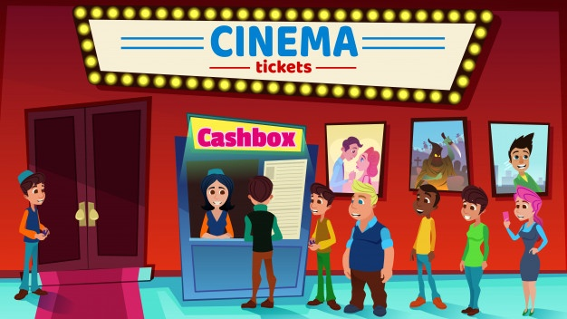
PRACTICE
2
Read the conversation again and choose the correct answer to each question.

Slide 12
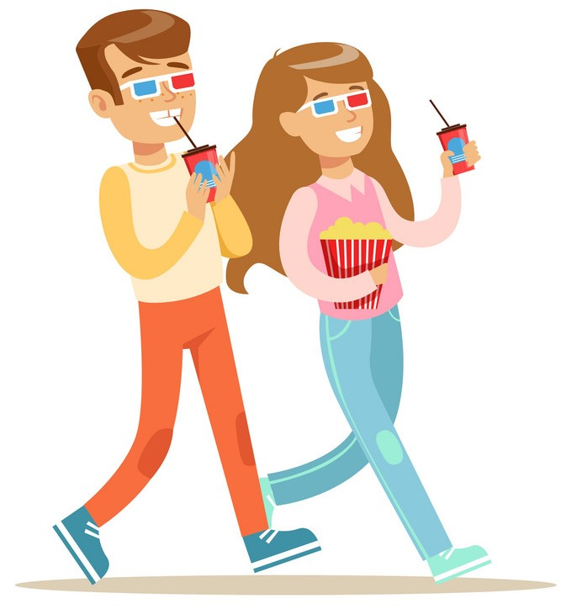
PRACTICE
2
Read the conversation again and choose the correct answer to each question.
1. What does Mark suggest doing tonight? A. Watching a TV show. B. Watching a film. C. Staying at home.
Mark: Let’s go to the cinema tonight! Hoa: Good idea! What shall we see?

Slide 13
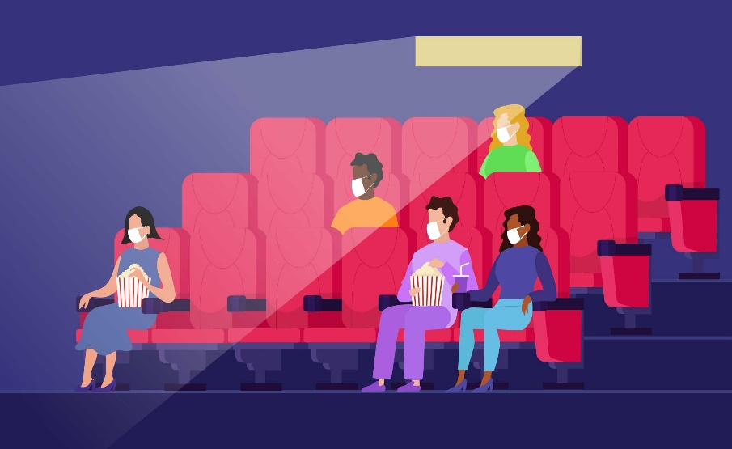
PRACTICE
2
Read the conversation again and choose the correct answer to each question.
2. Why doesn’t Mark want to see An Old Pier? A. He doesn’t like that type of film. B. It’s not on at a convenient time. C. He saw it last week.
Hoa: That’s too frightening for me. Look! An Old Pier is on at the Town Cinema. It’s a documentary. Mark: I don’t really like documentaries. They’re often boring. What about Our Holiday?

Slide 14
PRACTICE
2
Read the conversation again and choose the correct answer to each question.
3. The word “reviews” in the conversation mostly means ______. A. people’s opinions about the film B. interesting scenes in the film C. what people don’t like about the film

Slide 15
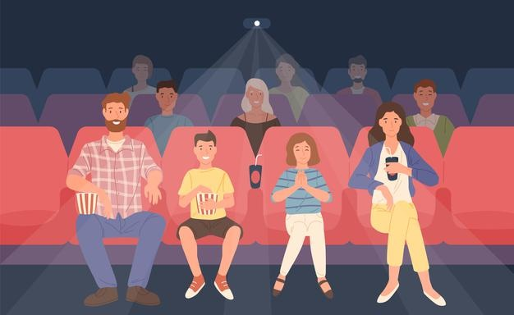
PRACTICE
2
Read the conversation again and choose the correct answer to each question.
4. What do people think of Our Holiday? A. Everyone likes it. B. No one likes it. C. Most people like it.
Hoa: What are the reviews like? Mark: Well, although a few people say it’s a bit silly, most say it’s funny and interesting.

Slide 16
PRACTICE
3
Choose the correct word or phrase to complete each of
the following sentences.
comedy
Game: Who is faster?
fantasy
science fiction film
Types of films
horror film
docu-mentary
cartoon

Slide 17
PRACTICE
3
Choose the correct word or phrase to complete each of
the following sentences.
comedy
Game: Who is faster?
Slap the correct types of films.
fantasy
science fiction film
Types of films
1. A film that tries to make the audience laugh is a ………………
horror film
docu-mentary
cartoon

Slide 18
PRACTICE
3
Choose the correct word or phrase to complete each of
the following sentences.
comedy
Game: Who is faster?
Slap the correct types of films.
fantasy
science fiction film
Types of films
2. A film that is based only on imagination, not on real facts, is a ……
horror film
docu-mentary
cartoon

Slide 19
PRACTICE
3
Choose the correct word or phrase to complete each of
the following sentences.
comedy
Game: Who is faster?
Slap the correct types of films.
fantasy
science fiction film
Types of films
3. A film that shows real life events or stories is a ……………..
horror film
docu-mentary
cartoon

Slide 20
PRACTICE
3
Choose the correct word or phrase to complete each of
the following sentences.
comedy
Game: Who is faster?
Slap the correct types of films.
fantasy
science fiction film
Types of films
4. A film that is set in the future, often about science, is a …………..
horror film
docu-mentary
cartoon

Slide 21
PRACTICE
3
Choose the correct word or phrase to complete each of
the following sentences.
comedy
Game: Who is faster?
Slap the correct types of films.
fantasy
science fiction film
Types of films
5. A film in which strange and frightening things happen is a ………..
horror film
docu-mentary
cartoon

Slide 22
PRACTICE
4
Complete the following sentences with the words in the box.
funny
interesting
frightening
moving
boring
1. Going to the hospital can be _________________ for a child. 2. The film was so _______________ that the audience couldn’t stop laughing. 3. Many people cried when they saw the _______________ scenes of the film. 4. The film last night was so _______________ that we fell asleep. 5. This book is ________________. I got a lot of useful information from it.
frightening
funny
moving
boring
interesting

Slide 23
PRACTICE
5
Work in pairs. ask and answer about a type of film. Use some of the adjectives in Task 4.
Example: A: Do you like documentaries? B: No, I don’t. A: Why not? B: I think they’re boring.

Slide 24
Topic of the unit
FILMS
Vocabulary
Types of films
Adjectives describing films

Slide 25
Homework
Think about your favourite film,use at least 3 adjectives to describe it.
Learn by heart new words.
Do exercise A1,2/B1,2,3 on page 60-61 in Work book.

